Slide 1


______________________________________
AMARAVATI CAMPUS
Tentative Title: PRODUCT RECOMMENDATION SYSTEM USING COLLABRATIVE FILTERING WITH PYSPARK
Batch No:
A. Charith (AV.EN.U4AIE22001)
B. Natraj Koushik Reddy (AV.EN.U4AIE22004)
V. Varun Sai (AV.EN.U4AIE22046)
D. Sridhar Adithya (AV.EN.U4AIE22049)
Under the guidance of:
Dr. V Lakshmi Chetana
Assistant Professor (Sl. Gr.)
Department of Computer Science and Engineering,
School of Computing

Slide 2
CONTENTS
Introduction (About the topic)
Motivation of Work
Objective of work
Literature Survey (Summary of key existing works in your domain)
Datasets to be used in your work
References

Slide 3
Introduction
A Product Recommendation System is a type of information filtering system that predicts and suggests products or items that a user might be interested in. Collaborative Filtering (CF) is one of the most popular techniques used in recommendation systems. It works by identifying patterns in user-item interactions (e.g., ratings, purchases, or clicks) and recommending items that similar users have liked.
In this project, we will build a Collaborative Filtering-based Recommendation System using PySpark, which is a distributed computing framework designed for big data processing. PySpark provides scalable and efficient tools for implementing machine learning algorithms, making it ideal for handling large datasets commonly encountered in recommendation systems.

Slide 4
Motivation of Work
Enhancing User Experience: Personalized recommendations improve user engagement by suggesting relevant products, leading to higher satisfaction and retention.
Driving Business Growth: Effective recommendation systems increase sales and conversions by promoting products tailored to user preferences.
Handling Large-Scale Data: PySpark enables scalable processing of massive datasets, making it ideal for real-world applications with millions of users and products.
Leveraging Advanced Techniques: Collaborative Filtering, especially with matrix factorization, provides accurate predictions by uncovering hidden patterns in user-item interactions.

Slide 5
Objective of Work
Develop a recommendation system using PySpark that can handle large-scale datasets efficiently, ensuring scalability for real-world applications.
Utilize matrix factorization techniques like ALS (Alternating Least Squares) to predict user preferences and generate accurate product recommendations.
Assess the system's effectiveness using metrics such as RMSE (Root Mean Squared Error) to ensure reliable and high-quality recommendations.
Deliver top-N personalized product suggestions for each user, enhancing user experience and engagement.

Slide 6
Literature Survey
Reference | Year of Publication | Datasets used | Description | Limitations of existing work / Research Gaps
[1] N. Fatic, M. Krupic, S. Jukic | 2023 | Amazon Reviews Dataset | Combined big data technologies with machine learning to create a recommendation model | While effective, the study doesn't address real-time recommendation capabilities
[2] Thom Lake, Sinead A. Williamson, Alexander T. Hawk | 2019 | Proprietary E-commerce Dataset | Developed a deep learning-based solution combining neural attention mechanisms with representation learning | Utilizes proprietary data, hindering result replication; does not address cold-start problems.
[3] Raif Rizvi | 2021 | Amazon Product Dataset | Developed a recommendation system using PySpark’s ALS algorithm | Focused on ALS; hybrid filtering and deep learning techniques were not explored.

Slide 7
Literature Survey
Reference | Year of Publication | Datasets used | Description | Limitations of existing work / Research Gaps
[4] Yifan Hu, Yehuda Koren, and Chris Volinsky | 2013 | Netflix Prize Dataset | Proposed an Alternating Least Squares (ALS) approach tailored for implicit feedback | Focused on movie data; applicability to other domains remains unexplored.
[5] Wei Jin et al. | 2023 | Amazon-M2 Dataset | Proposed a multilingual shopping dataset to enhance personalized recommendation systems. | Benchmarking with collaborative filtering in PySpark is yet to be explored.

Slide 8
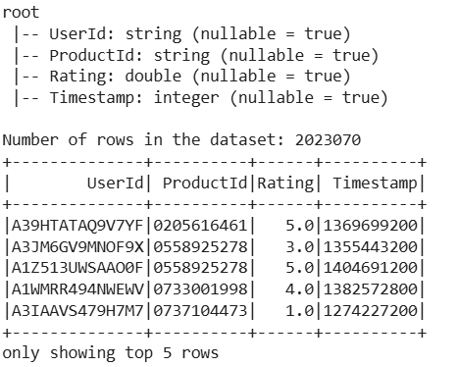
Dataset Description
The dataset used in this project is the User-Product Interaction dataset obtained from an e-commerce platform. This dataset is designed to build a product recommendation system based on user ratings for various products. The dataset contains explicit feedback in the form of ratings provided by users for products.
File Name: rating_beauty.csv
Size: 2,023,070 rows × 4 columns
UserId – A unique identifier for each user (String)
ProductId – A unique identifier for each Product (String)
Rating – The rating given by the user to the product.(Int)
Timestamp – The time when the rating was provided.(Int)

